Slide 1


Reddit Wholesome Meter (RWM)
A Sentiment Analyzer of Reddit

Slide 2
Why RWM?
Every subreddit is completely different.
Sentiment Analysis

Slide 3


Tech Stack
Python
PRAW
Textblob (NLTK)
Numpy, Matplotlib

Slide 4

Demo

Slide 5
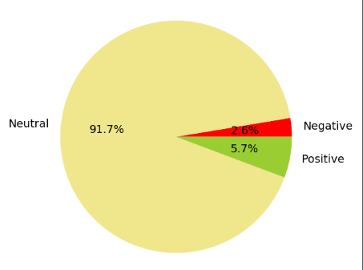
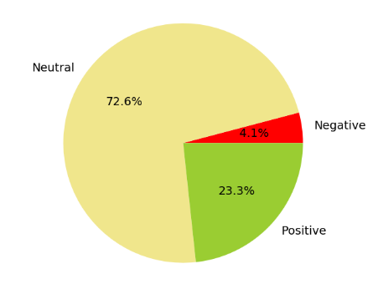
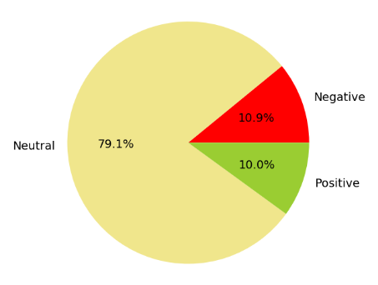
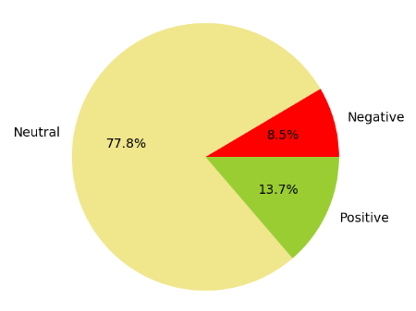
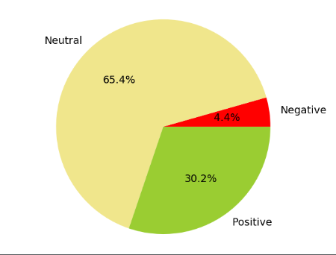
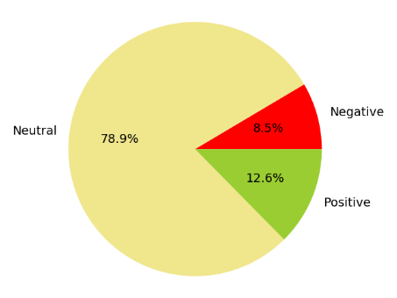
Data
r/learnPython
r/food
r/politics
r/funny
r/CasualConversation
r/RoastMe

Slide 6
Conclusion
Sentiment Analysis imperfect
Misses jokes, sarcasm, twists.
New Reddit Filter setting?

